Slide 1

Introduction to PHP
Dr. Charles Severance
www.wa4e.com
Notes:
Note from Chuck. If you are using these materials, you can remove my name and URL from this replace it with your own, but please retain the CC-BY logo on the first page as well as retain the entire last page when you remix and republish these slides.

Slide 2
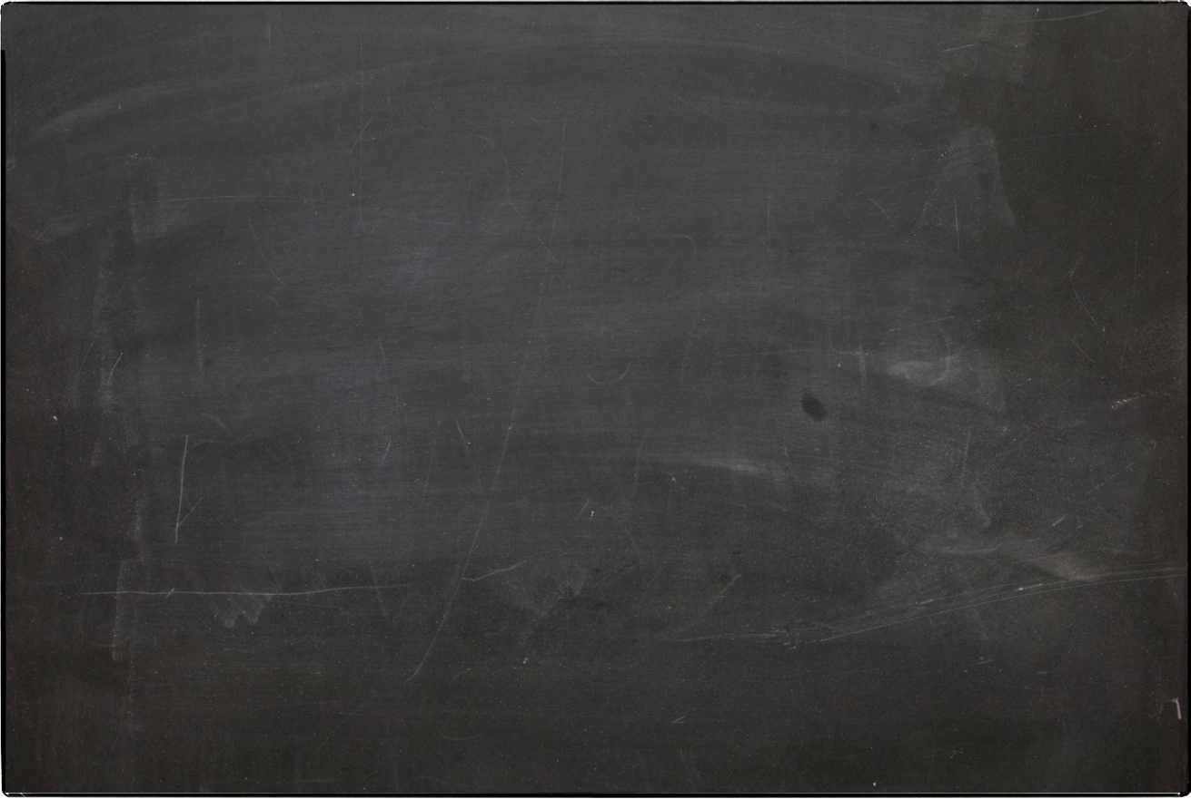
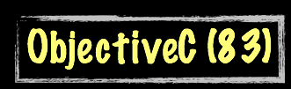
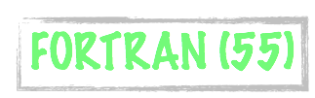


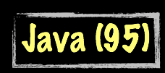





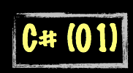
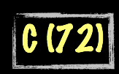
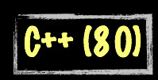

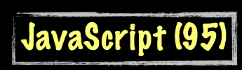



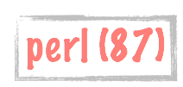
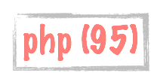

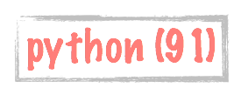
Science Calculations
System
System
C uses curly braces { } for code blocks.
Scripting/
Interpreted
http://en.wikipedia.org/wiki/History_of_programming_languages

Slide 3
About the PHP Language
Syntax inspired by C
  - Curly braces, semicolons, no significant whitespace
Syntax inspired by perl
  - Dollar signs to start variable names, associative arrays
Extends HTML to add segments of PHP within an HTML file

Slide 4
Philosophy of PHP
You are a responsible and intelligent programmer.
You know what you want to do.
Some flexibility in syntax is OK - style choices are OK.
Let’s make this as convenient as possible.
Sometimes errors fail silently.

Slide 5
<h1>Hello from Dr. Chuck's HTML Page</h1>
<p>
<?php
echo "Hi there.\n";
$answer = 6 * 7;
echo "The answer is $answer, what ";
echo "was the question again?\n";
?>
</p>
<p>Yes another paragraph.</p>

Slide 6
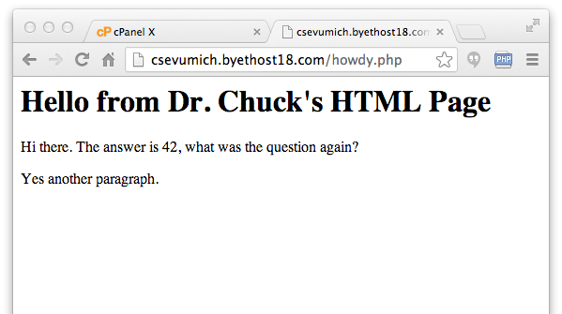
<h1>Hello from Dr. Chuck's HTML Page</h1>
<p>
<?php
echo "Hi there.\n";
$answer = 6 * 7;
echo "The answer is $answer, what ";
echo "was the question again?\n";
?>
</p>
<p>Yes another paragraph.</p>

Slide 7
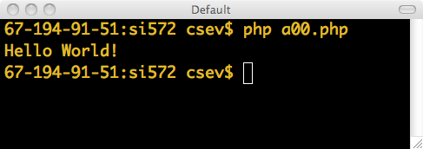
PHP from the Command Line
You can run PHP from the command line - the output simply comes out on the terminal.
It does not have to be part of a request-response cycle.
<?php
echo("Hello World!");
echo("\n");
?>

Slide 8
Basic Syntax

Slide 9
Keywords
abstract and array() as break case catch class clone const continue declare default do else elseif end declare endfor endforeach endif endswitch endwhile extends final for foreach function global goto if implements interface instanceof namespace new or private protected public static switch $this throw try use var while xor
http://php.net/manual/en/reserved.php

Slide 10
Variable Names
Start with a dollar sign ($) followed by a letter or underscore, followed by any number of letters, numbers, or underscores
Case matters
$abc = 12;
$total = 0;
$largest_so_far = 0;
abc = 12;
$2php = 0;
$bad-punc = 0;
http://php.net/manual/en/language.variables.basics.php

Slide 11
Variable Name Weirdness
Things that look like variables but are missing a dollar sign can be confusing.
$x = 2;
$y = x + 5;
print $y;
$x = 2;
y = $x + 5;
print $x;
5
Parse error

Slide 12
Variable Name Weirdness
Things that look like variables but are missing a dollar sign as an array index are unpredictable....
$x = 5;
$y = array("x" => "Hello");
print $y[x];
Hello

Slide 13
Strings / Different + Awesome
String literals can use single quotes or double quotes.
The backslash (\) is used as an “escape” character.
Strings can span multiple lines - the newline is part of the string.
In double-quoted strings, variable values are expanded.
Concatenation is the "." not "+" (more later).
http://php.net/manual/en/language.types.string.php

Slide 14
<?php
echo "this is a simple string\n";
echo "You can also have embedded newlines in
strings this way as it is
okay to do";
// Outputs: This will expand:
// a newline
echo "This will expand: \na newline";
// Outputs: Variables do 12
$expand = 12;
echo "Variables do $expand\n";
Double Quote

Slide 15
<?php
echo 'this is a simple string';
echo 'You can also have embedded newlines in
strings this way as it is
okay to do';
// Outputs: Arnold once said: "I'll be back"
echo 'Arnold once said: "I\'ll be back"';
// Outputs: This will not expand: \n a newline
echo 'This will not expand: \n a newline';
// Outputs: Variables do not $expand $either
echo 'Variables do not $expand $either';
Single Quote

Slide 16
Comments in PHP ☺
echo 'This is a test'; // This is a c++ style comment
/* This is a multi line comment
yet another line of comment */
echo 'This is yet another test';
echo 'One Final Test'; # This is a shell-style comment
http://php.net/manual/en/language.basic-syntax.comments.php

Slide 17
Output
<?php
$x = "15" + 27;
echo $x;
echo("\n");
echo $x, "\n";
print $x;
print "\n";
print($x);
print("\n");
?>
echo is a language construct - can be treated like a function with one parameter. Without parentheses, it accepts multiple parameters.
print is a function - only one parameter, but parentheses are optional so it can look like a language construct.

Slide 18
Expressions

Slide 19
Expressions
Completely normal like other languages ( + - / * )
More aggressive implicit type conversion
<?php
$x = "15" + 27;
echo($x);
echo("\n");
?>
42

Slide 20
Expressions
Expressions evaluate to a value. The value can be a string, number, boolean, etc.
Expressions often use operations and function calls. There is an order of evaluation when there is more than one operator in an expression.
Expressions can also produce objects like arrays.

Slide 21
Operators of Note
Increment / Decrement ( ++ -- )
String concatenation ( . )
Equality ( == != )
Identity ( === !== )
Ternary ( ? : )
Side-effect Assignment ( += -= .= etc.)
Ignore the rarely-used bitwise operators ( >> << ^ | & )

Slide 22
Increment / Decrement
These operators allow you to both retrieve and increment / decrement a variable.
They are generally avoided in civilized code.
$x = 12;
$y = 15 + $x++;
echo "x is $x and y is $y \n";
x is 13 and y is 27

Slide 23
Increment / Decrement
These operators allow you to both retrieve and increment / decrement a variable.
They are generally avoided in civilized code.
$x = 12;
$y = 15 + $x;
$x = $x + 1;
echo "x is $x and y is $y \n";
x is 13 and y is 27

Slide 24
String Concatenation
PHP uses the period character for concatenation, because the plus character would instruct PHP to do the best it could to add the two things together, converting if necessary.
$a = 'Hello ' . 'World!';
echo $a . "\n";
Hello World!

Slide 25
Ternary
The ternary operator comes from C. It allows conditional expressions. It is like a one-line if-then-else. Like all “contraction” syntaxes, we must use it carefully.
$www = 123;
$msg = $www > 100 ? "Large" : "Small" ;
echo "First: $msg \n";
$msg = ( $www % 2 == 0 ) ? "Even" : "Odd";
echo "Second: $msg \n";
$msg = ( $www % 2 ) ? "Odd" : "Even";
echo "Third: $msg \n";
First: Large
Second: Odd
Third: Odd

Slide 26
Side-Effect Assignment
These are pure contractions. Use them sparingly.
echo "\n";
$out = "Hello";
$out = $out . " ";
$out .= "World!";
$out .= "\n";
echo $out;
$count = 0;
$count += 1;
echo "Count: $count\n";
Hello World!
Count: 1

Slide 27
Conversion / Casting
As PHP evaluates expressions, sometimes values in the expression need to be converted from one type to another as the computations are done.
    PHP does aggressive implicit type conversion (casting).
    You can also make type conversion (casting) explicit with casting operators.

Slide 28
Casting
In PHP, division forces operands to be floating point. PHP converts expression values silently and aggressively.
$a = 56; $b = 12;
$c = $a / $b;
echo "C: $c\n";
$d = "100" + 36.25 + TRUE;
echo "D: ". $d . "\n";
echo "D2: ". (string) $d . "\n";
$e = (int) 9.9 - 1;
echo "E: $e\n";
$f = "sam" + 25;
echo "F: $f\n";
$g = "sam" . 25;
echo "G: $g\n";
C: 4.66666666667
D: 137.25
D2: 137.25
E: 8
F: 25
G: sam25

Slide 29
PHP vs. Python
$x = "100" + 25;
echo "X: $x\n";
$y = "100" . 25;
echo "Y: $y\n";
$z = "sam" + 25;
echo "Z: $z\n";
x = int("100") + 25
print "X:", x
y = "100" + str(25)
print "Y:", y
z = int("sam") + 25
print "Z:", z
X: 125
Y: 10025
Z: 25
X: 125
Y: 10025
Traceback:"cast.py", line 5
z = int("sam") + 25;
ValueError: invalid literal

Slide 30
Casting
The concatenation operator tries to convert its operands to strings.
TRUE becomes an integer 1 and then becomes a string. FALSE is “not there” - it is even “smaller” than zero, at least when it comes to width.
echo "A".FALSE."B\n";
echo "X".TRUE."Y\n";
AB
X1Y

Slide 31
Equality versus Identity
The equality operator (==) in PHP is far more aggressive than in most other languages when it comes to data conversion during expression evaluation.
if ( 123 == "123" ) print ("Equality 1\n");
if ( 123 == "100"+23 ) print ("Equality 2\n");
if ( FALSE == "0" ) print ("Equality 3\n");
if ( (5 < 6) == "2"-"1" ) print ("Equality 4\n");
if ( (5 < 6) === TRUE ) print ("Equality 5\n");

Slide 32
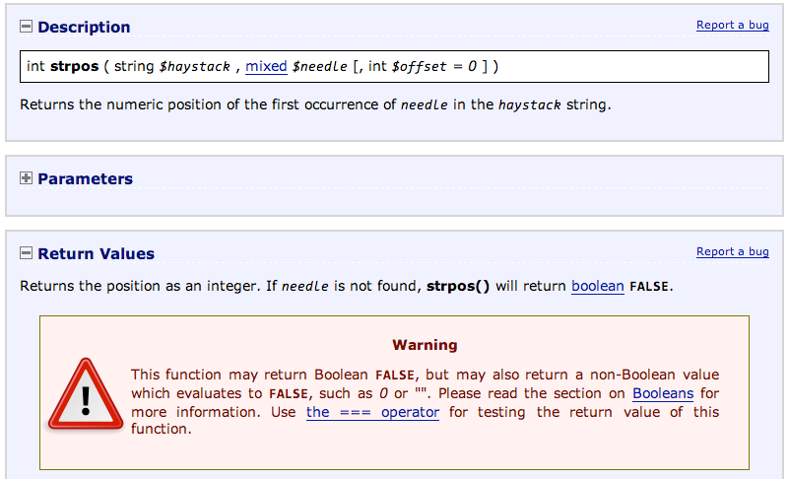
http://php.net/manual/en/function.strpos.php

Slide 33
$vv = "Hello World!";
echo "First:" . strpos($vv, "Wo") . "\n";
echo "Second: " . strpos($vv, "He") . "\n";
echo "Third: " . strpos($vv, "ZZ") . "\n";
if (strpos($vv, "He") == FALSE ) echo "Wrong A\n";
if (strpos($vv, "ZZ") == FALSE ) echo "Right B\n";
if (strpos($vv, "He") !== FALSE ) echo "Right C\n";
if (strpos($vv, "ZZ") === FALSE ) echo "Right D\n";
print_r(FALSE); print FALSE;
echo "Where were they?\n";
First:6
Second: 0
Third:
Wrong A
Right B
Right C
Right D
Where were they?
Beware FALSE variables. They are detectable but not visible...

Slide 34
Control Structures

Slide 35
Conditional - if
Logical operators ( == != < > <= >= && || ! )
Curly braces
<?php
$ans = 42;
if ( $ans == 42 ) {
print "Hello world!\n";
} else {
print "Wrong answer\n";
}
?>
Hello World!

Slide 36
Whitespace Does Not Matter
<?php
$ans = 42;
if ( $ans == 42 ) {
print "Hello world!\n";
} else {
print "Wrong answer\n";
}
?>
<?php $ans = 42; if ( $ans == 42 ) { print
"Hello world!\n"; } else { print "Wrong answer\n"; }
?>

Slide 37
Which Style do You Prefer?
<?php
$ans = 42;
if ( $ans == 42 )
{
print "Hello world!\n";
}
else
    {
print "Wrong answer\n";
}
?>
<?php
$ans = 42;
if ( $ans == 42 ) {
print "Hello world!\n";
} else {
print "Wrong answer\n";
}
?>
Aesthetics

Slide 38
Multi-way
yes
x < 2
print 'Small'
no
$x = 7;
if ( $x < 2 ) {
print "Small\n";
} elseif ( $x < 10 ) {
print "Medium\n";
} else {
print "LARGE\n";
}
print "All done\n";
yes
x<10
print 'Medium'
no
print 'LARGE'
print 'All Done'

Slide 39
Curly Braces are Not Required
if ($page == "Home") echo "You selected Home";
elseif ($page == "About") echo "You selected About";
elseif ($page == "News") echo "You selected News";
elseif ($page == "Login") echo "You selected Login";
elseif ($page == "Links") echo "You selected Links";
if ($page == "Home") { echo "You selected Home"; }
elseif ($page == "About") { echo "You selected About"; }
elseif ($page == "News") { echo "You selected News"; }
elseif ($page == "Login") { echo "You selected Login"; }
elseif ($page == "Links") { echo "You selected Links"; }

Slide 40
$fuel = 10;
while ($fuel > 1) {
print "Vroom vroom\n";
}
A while loop is a “zero-trip” loop with the test at the top before the first iteration starts. We hand construct the iteration variable to implement a counted loop.
$fuel = 10;
while ($fuel > 1) {
print "Vroom vroom\n";
$fuel = $fuel - 1;
}

Slide 41
$count = 1;
do {
echo "$count times 5 is " . $count * 5;
echo "\n";
} while (++$count <= 5);
A do-while loop is a “one-trip” loop with the test at the bottom after the first iteration completes.
1 times 5 is 5
2 times 5 is 10
3 times 5 is 15
4 times 5 is 20
5 times 5 is 25

Slide 42
for($count=1; $count<=6; $count++ ) {
echo "$count times 6 is " . $count * 6;
echo "\n";
}
1 times 6 is 6
2 times 6 is 12
3 times 6 is 18
4 times 6 is 24
5 times 6 is 30
6 times 6 is 36
A for loop is the simplest way to construct a counted loop.

Slide 43
Loop runs while TRUE (top-test)
Run after each iteration.
Before loop starts
for($count=1; $count<=6; $count++ ) {
echo "$count times 6 is " . $count * 6;
echo "\n";
}
1 times 6 is 6
2 times 6 is 12
3 times 6 is 18
4 times 6 is 24
5 times 6 is 30
6 times 6 is 36
A for loop is the simplest way to construct a counted loop.

Slide 44
Breaking Out of a Loop
The break statement ends the current loop and jumps to the statement immediately following the loop.
It is like a loop test that can happen anywhere in the body of the loop.
for($count=1; $count<=600; $count++ ) {
if ( $count == 5 ) break;
echo "Count: $count\n";
}
echo "Done\n";
Count: 1
Count: 2
Count: 3
Count: 4
Done

Slide 45
Finishing an Iteration with continue
The continue statement ends the current iteration. jumps to the top of the loop, and starts the next iteration.
Count: 1
Count: 3
Count: 5
Count: 7
Count: 9
Done
for($count=1; $count<=10; $count++ ) {
if ( ($count % 2) == 0 ) continue;
echo "Count: $count\n";
}
echo "Done\n";

Slide 46
Summary
This is a sprint through some of the unique language features of PHP.

Slide 47
Acknowledgements / Contributions
These slides are Copyright 2010- Charles R. Severance (www.dr-chuck.com) as part of www.wa4e.com and made available under a Creative Commons Attribution 4.0 License. Please maintain this last slide in all copies of the document to comply with the attribution requirements of the license. If you make a change, feel free to add your name and organization to the list of contributors on this page as you republish the materials.
Initial Development: Charles Severance, University of Michigan School of Information
Insert new Contributors and Translators here including names and dates
Continue new Contributors and Translators here
Notes:
Note from Chuck. Please retain and maintain this page as you remix and republish these materials. Please add any of your own improvements or contributions.

